Slide 1
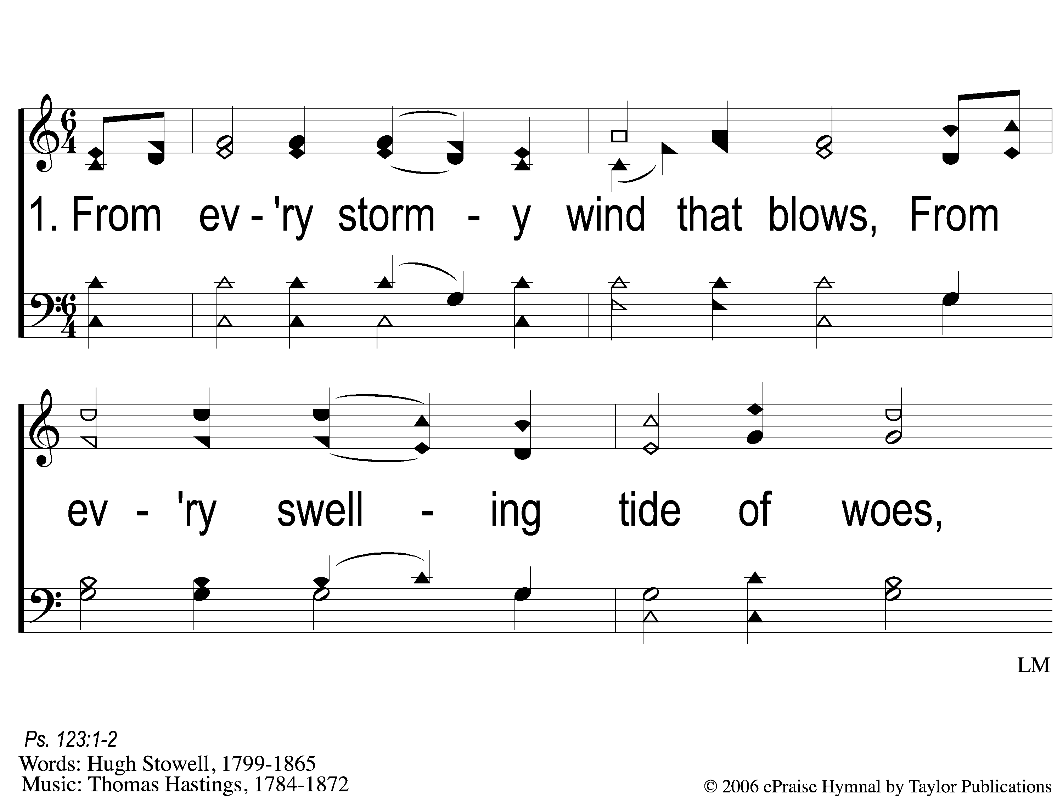
1-1 From Every Stormy Wind
From Every Stormy Wind
115

Slide 2
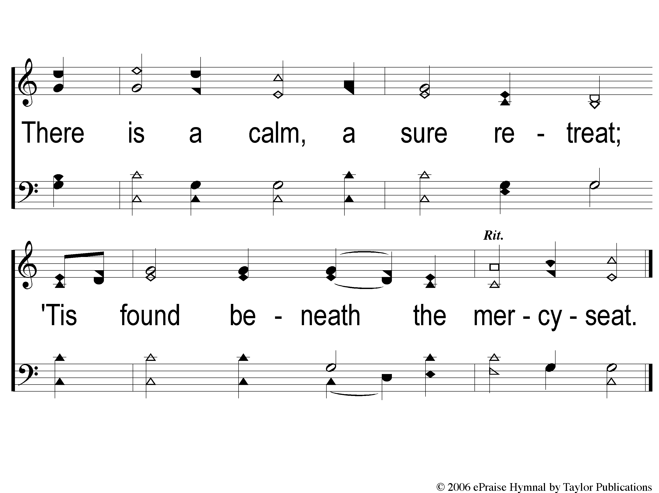
1-2 From Every Stormy Wind
From Every Stormy Wind
115

Slide 3
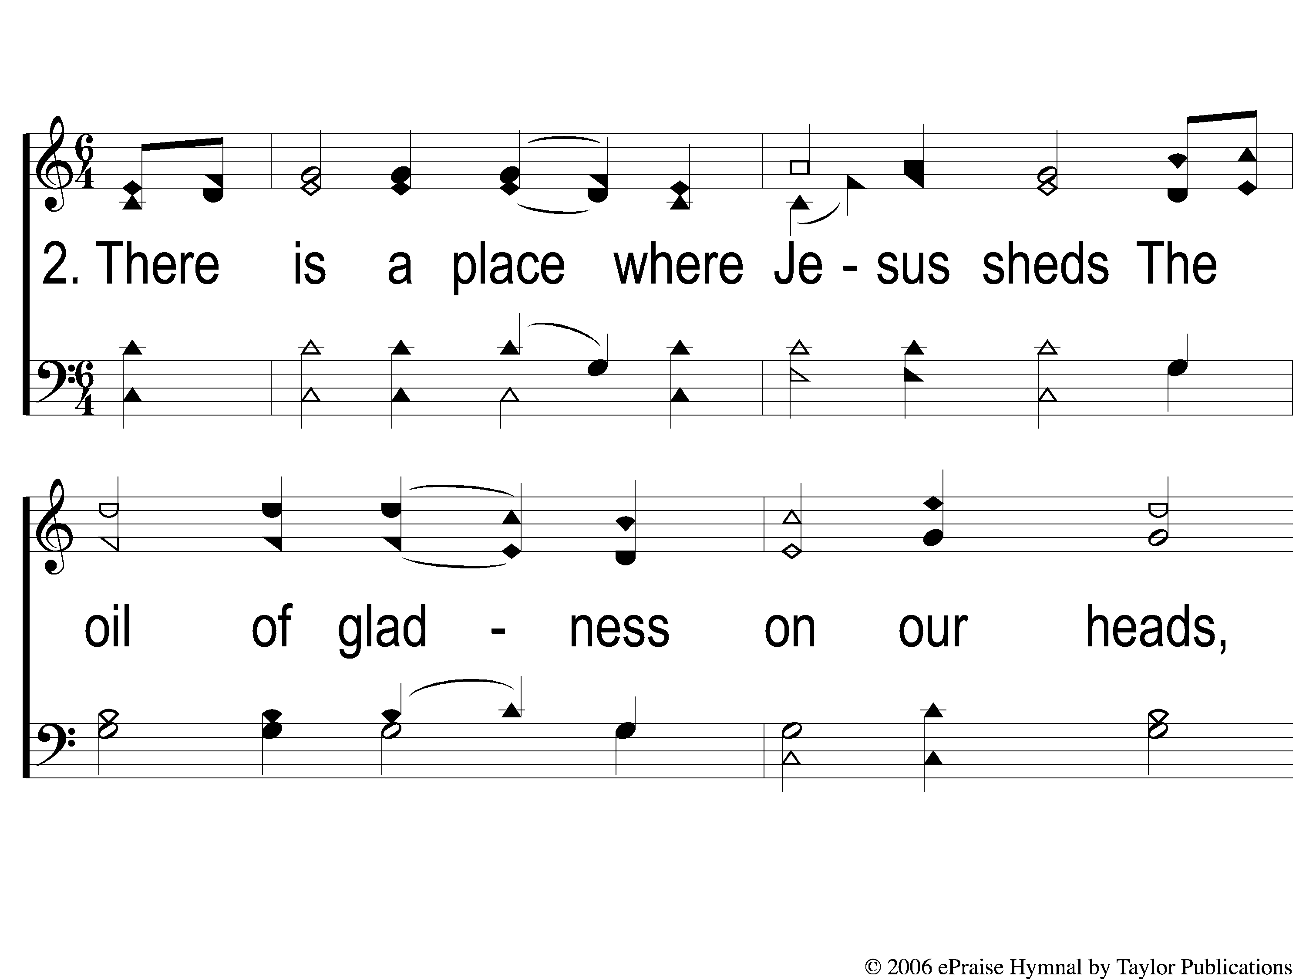
2-1 From Every Stormy Wind
From Every Stormy Wind
115

Slide 4
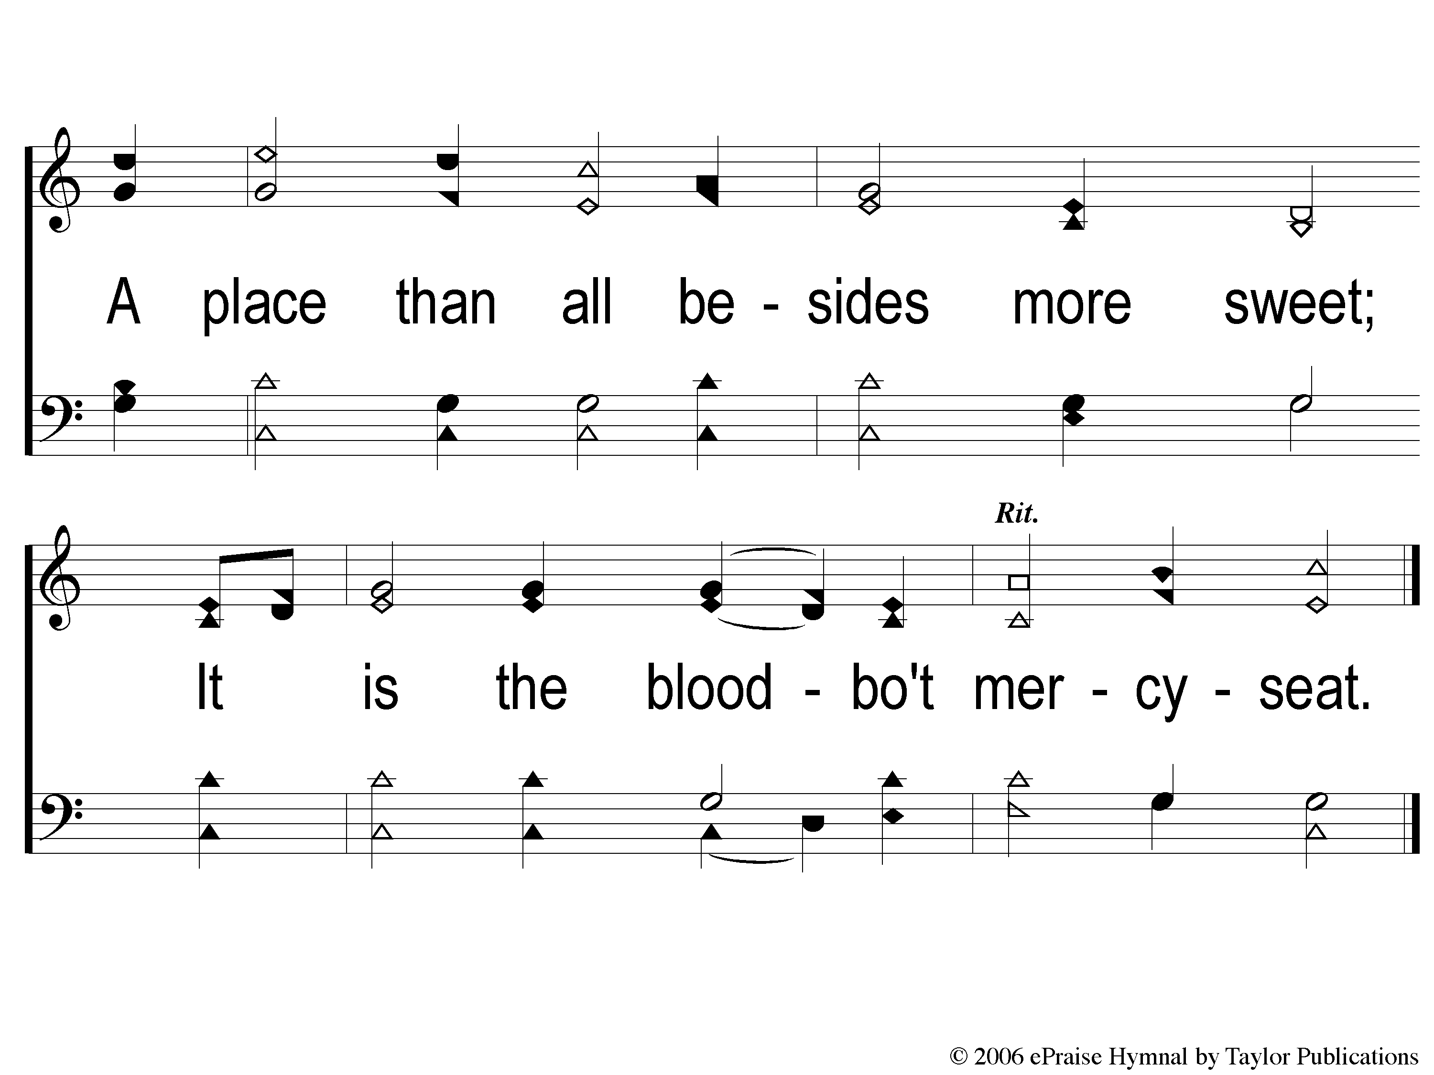
2-2 From Every Stormy Wind
From Every Stormy Wind
115

Slide 5
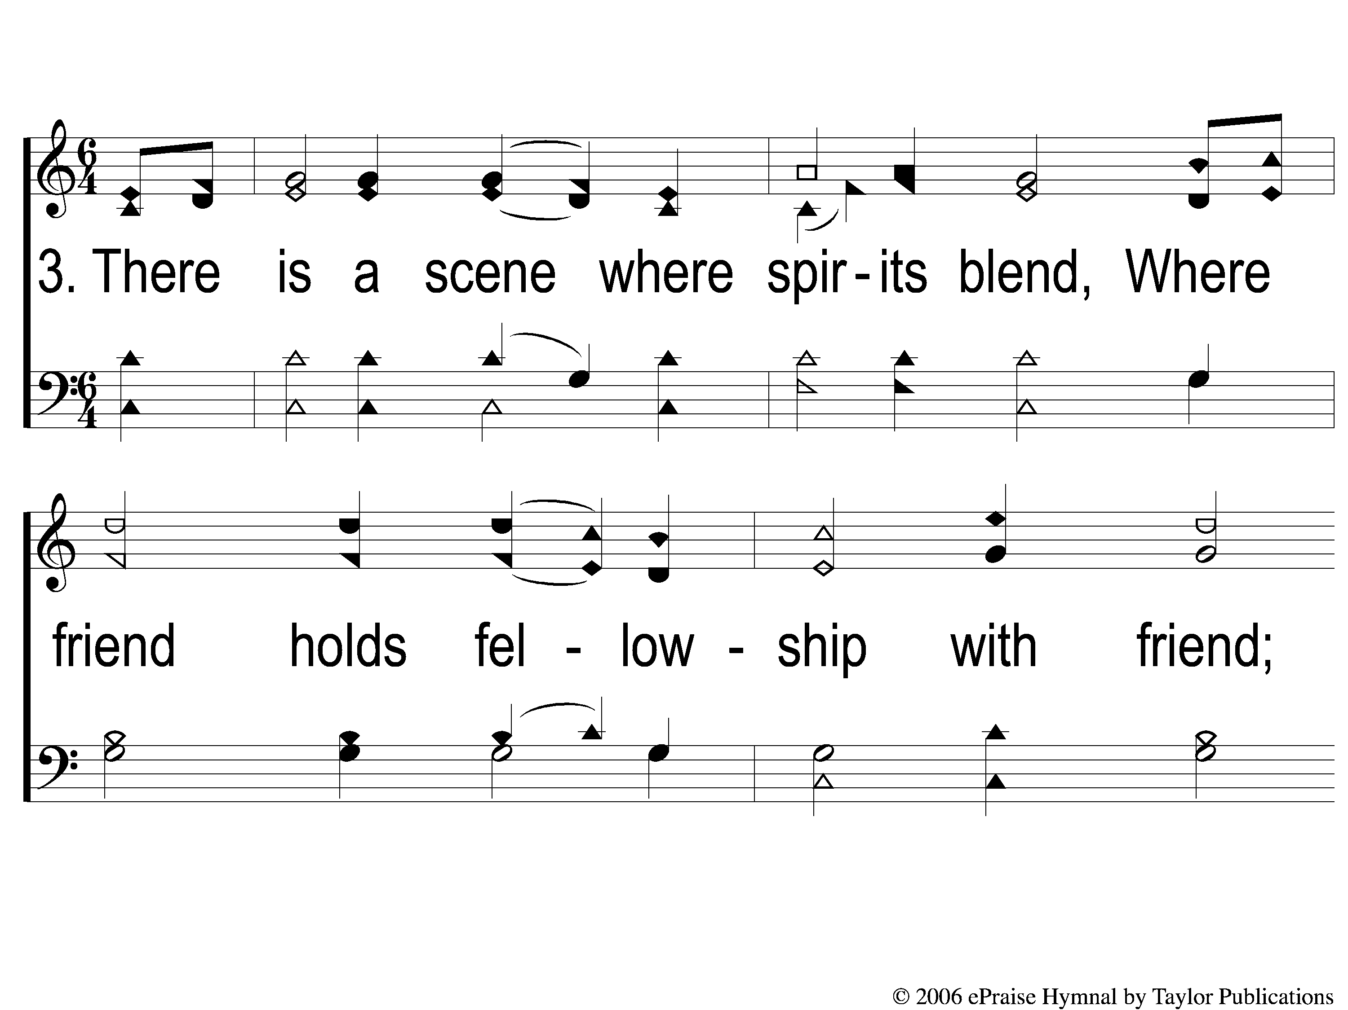
3-1 From Every Stormy Wind
From Every Stormy Wind
115

Slide 6
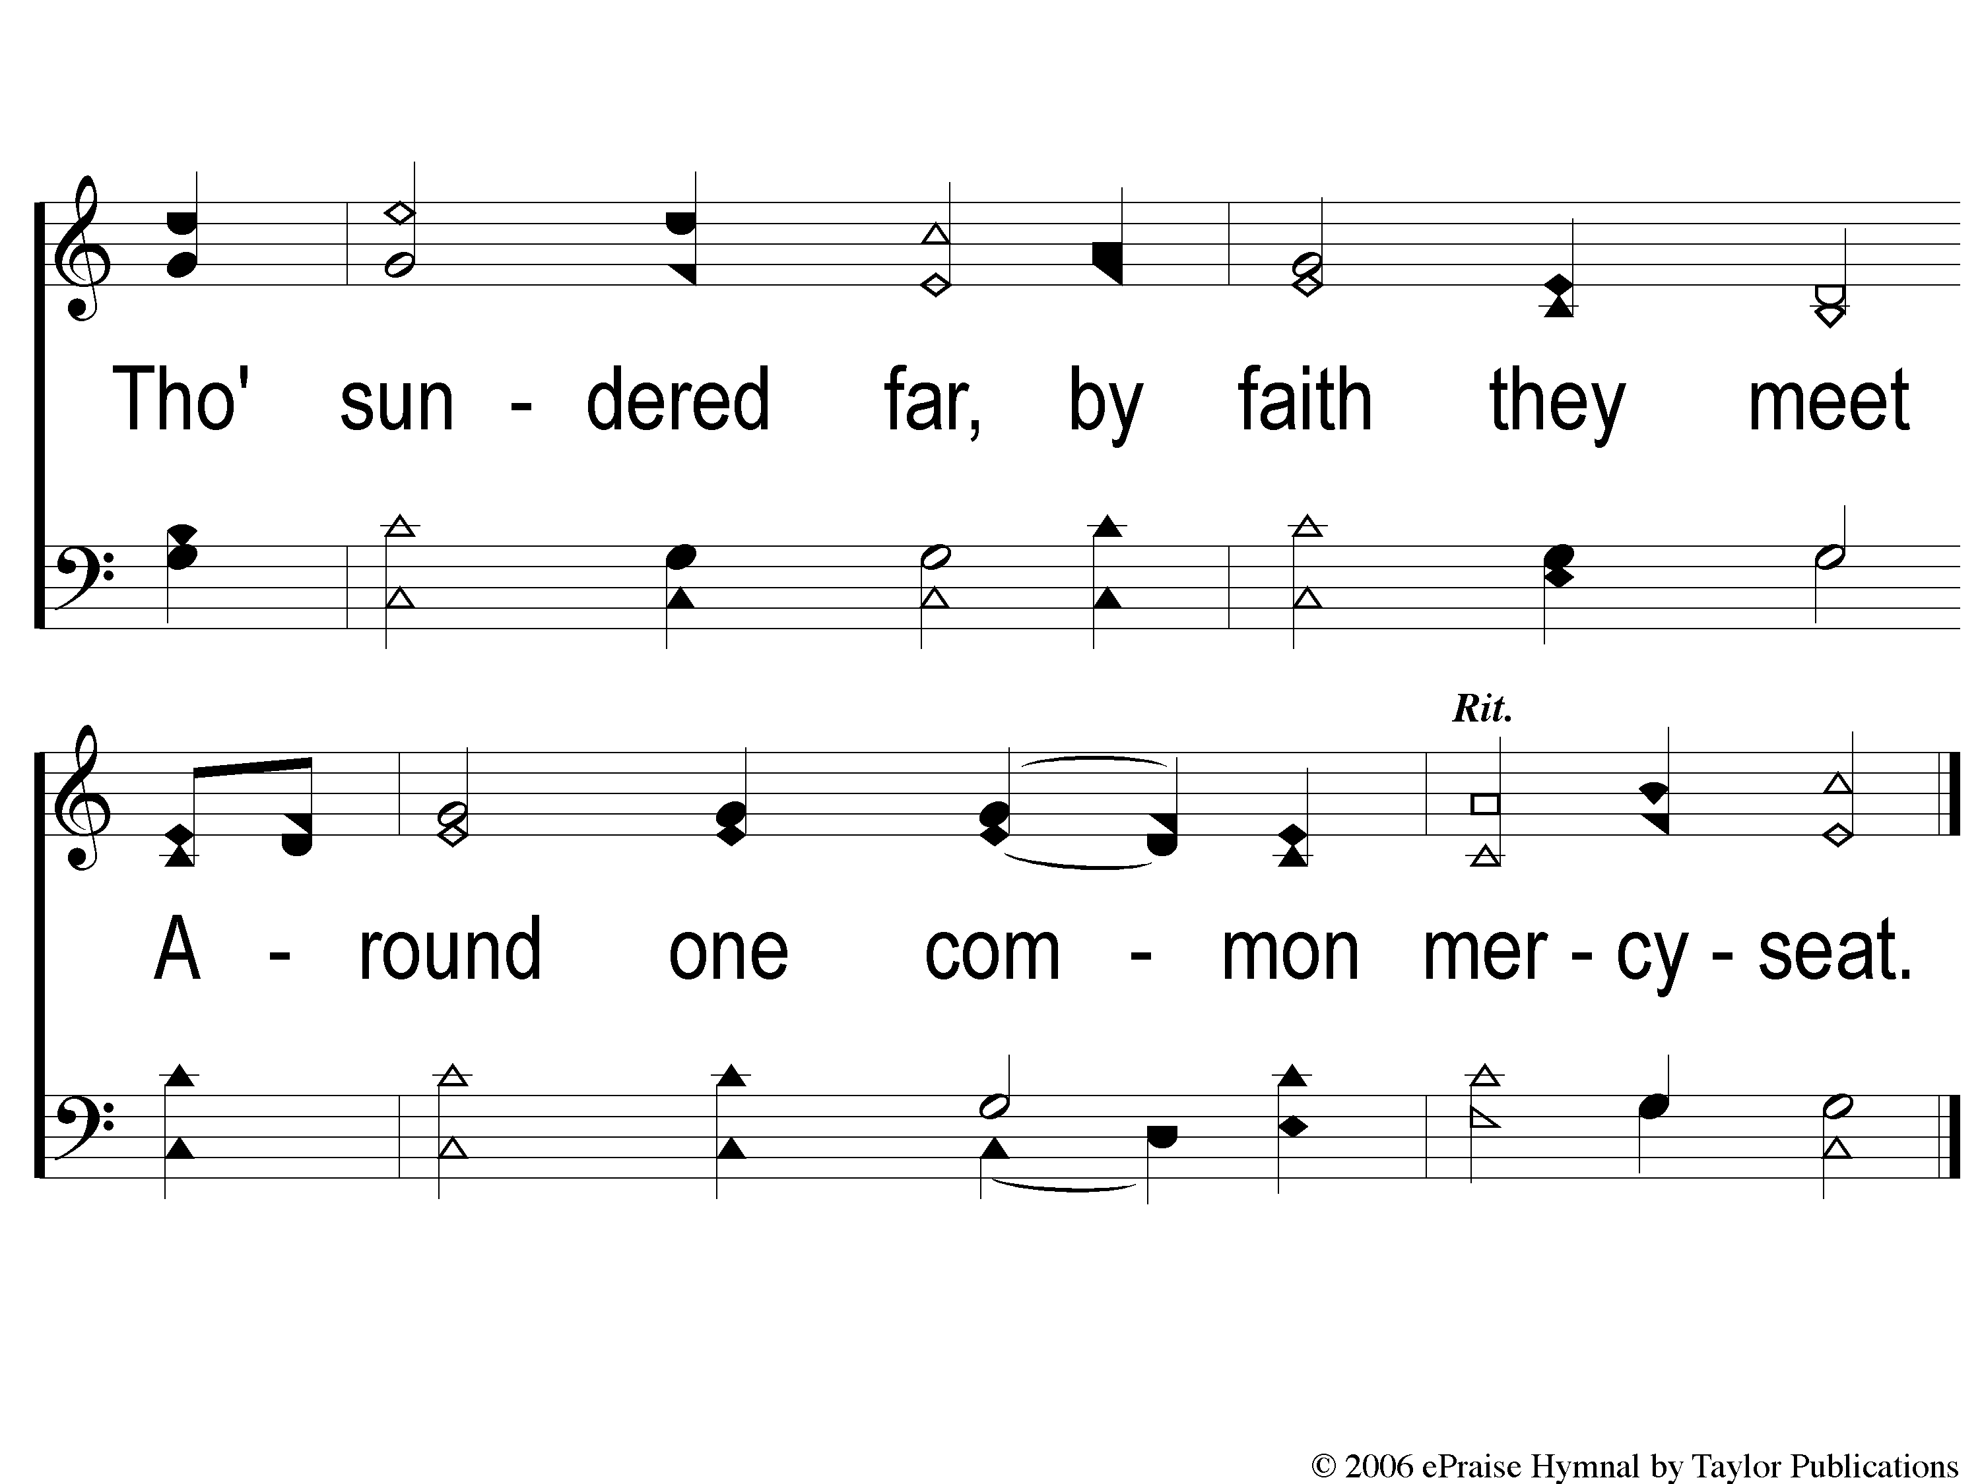
3-2 From Every Stormy Wind
From Every Stormy Wind
115

Slide 7
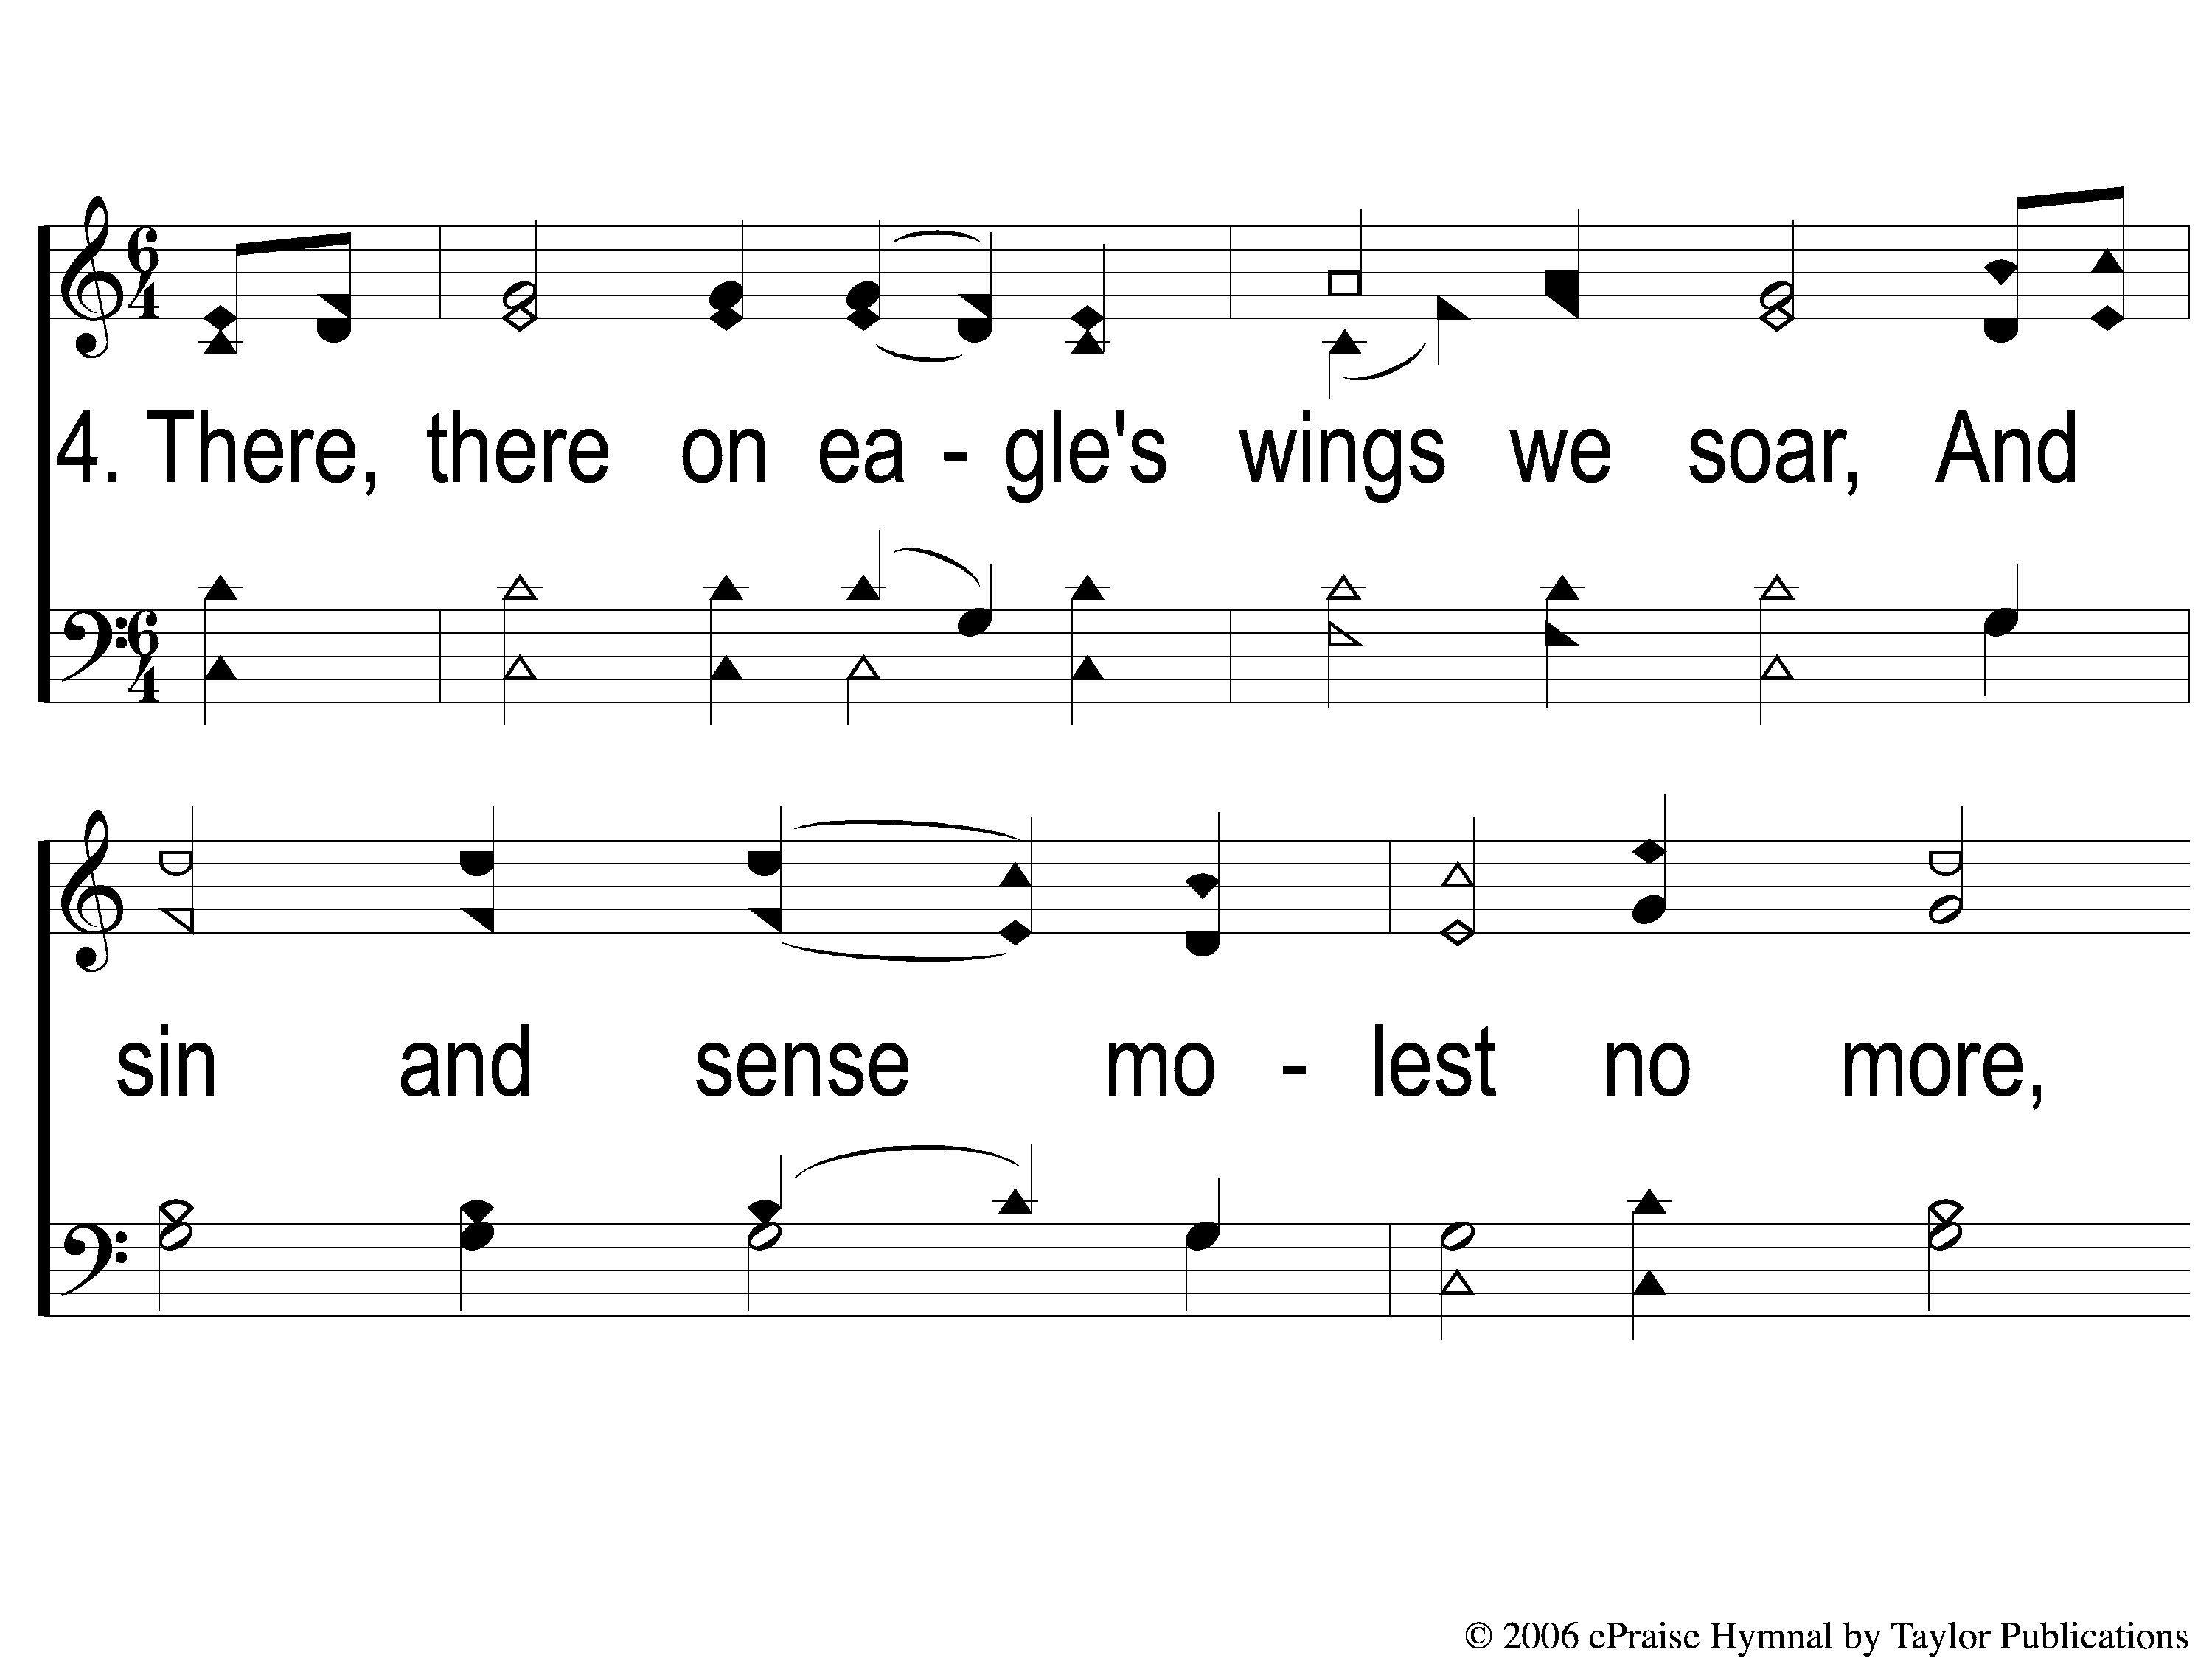
4-1 From Every Stormy Wind
From Every Stormy Wind
115

Slide 8
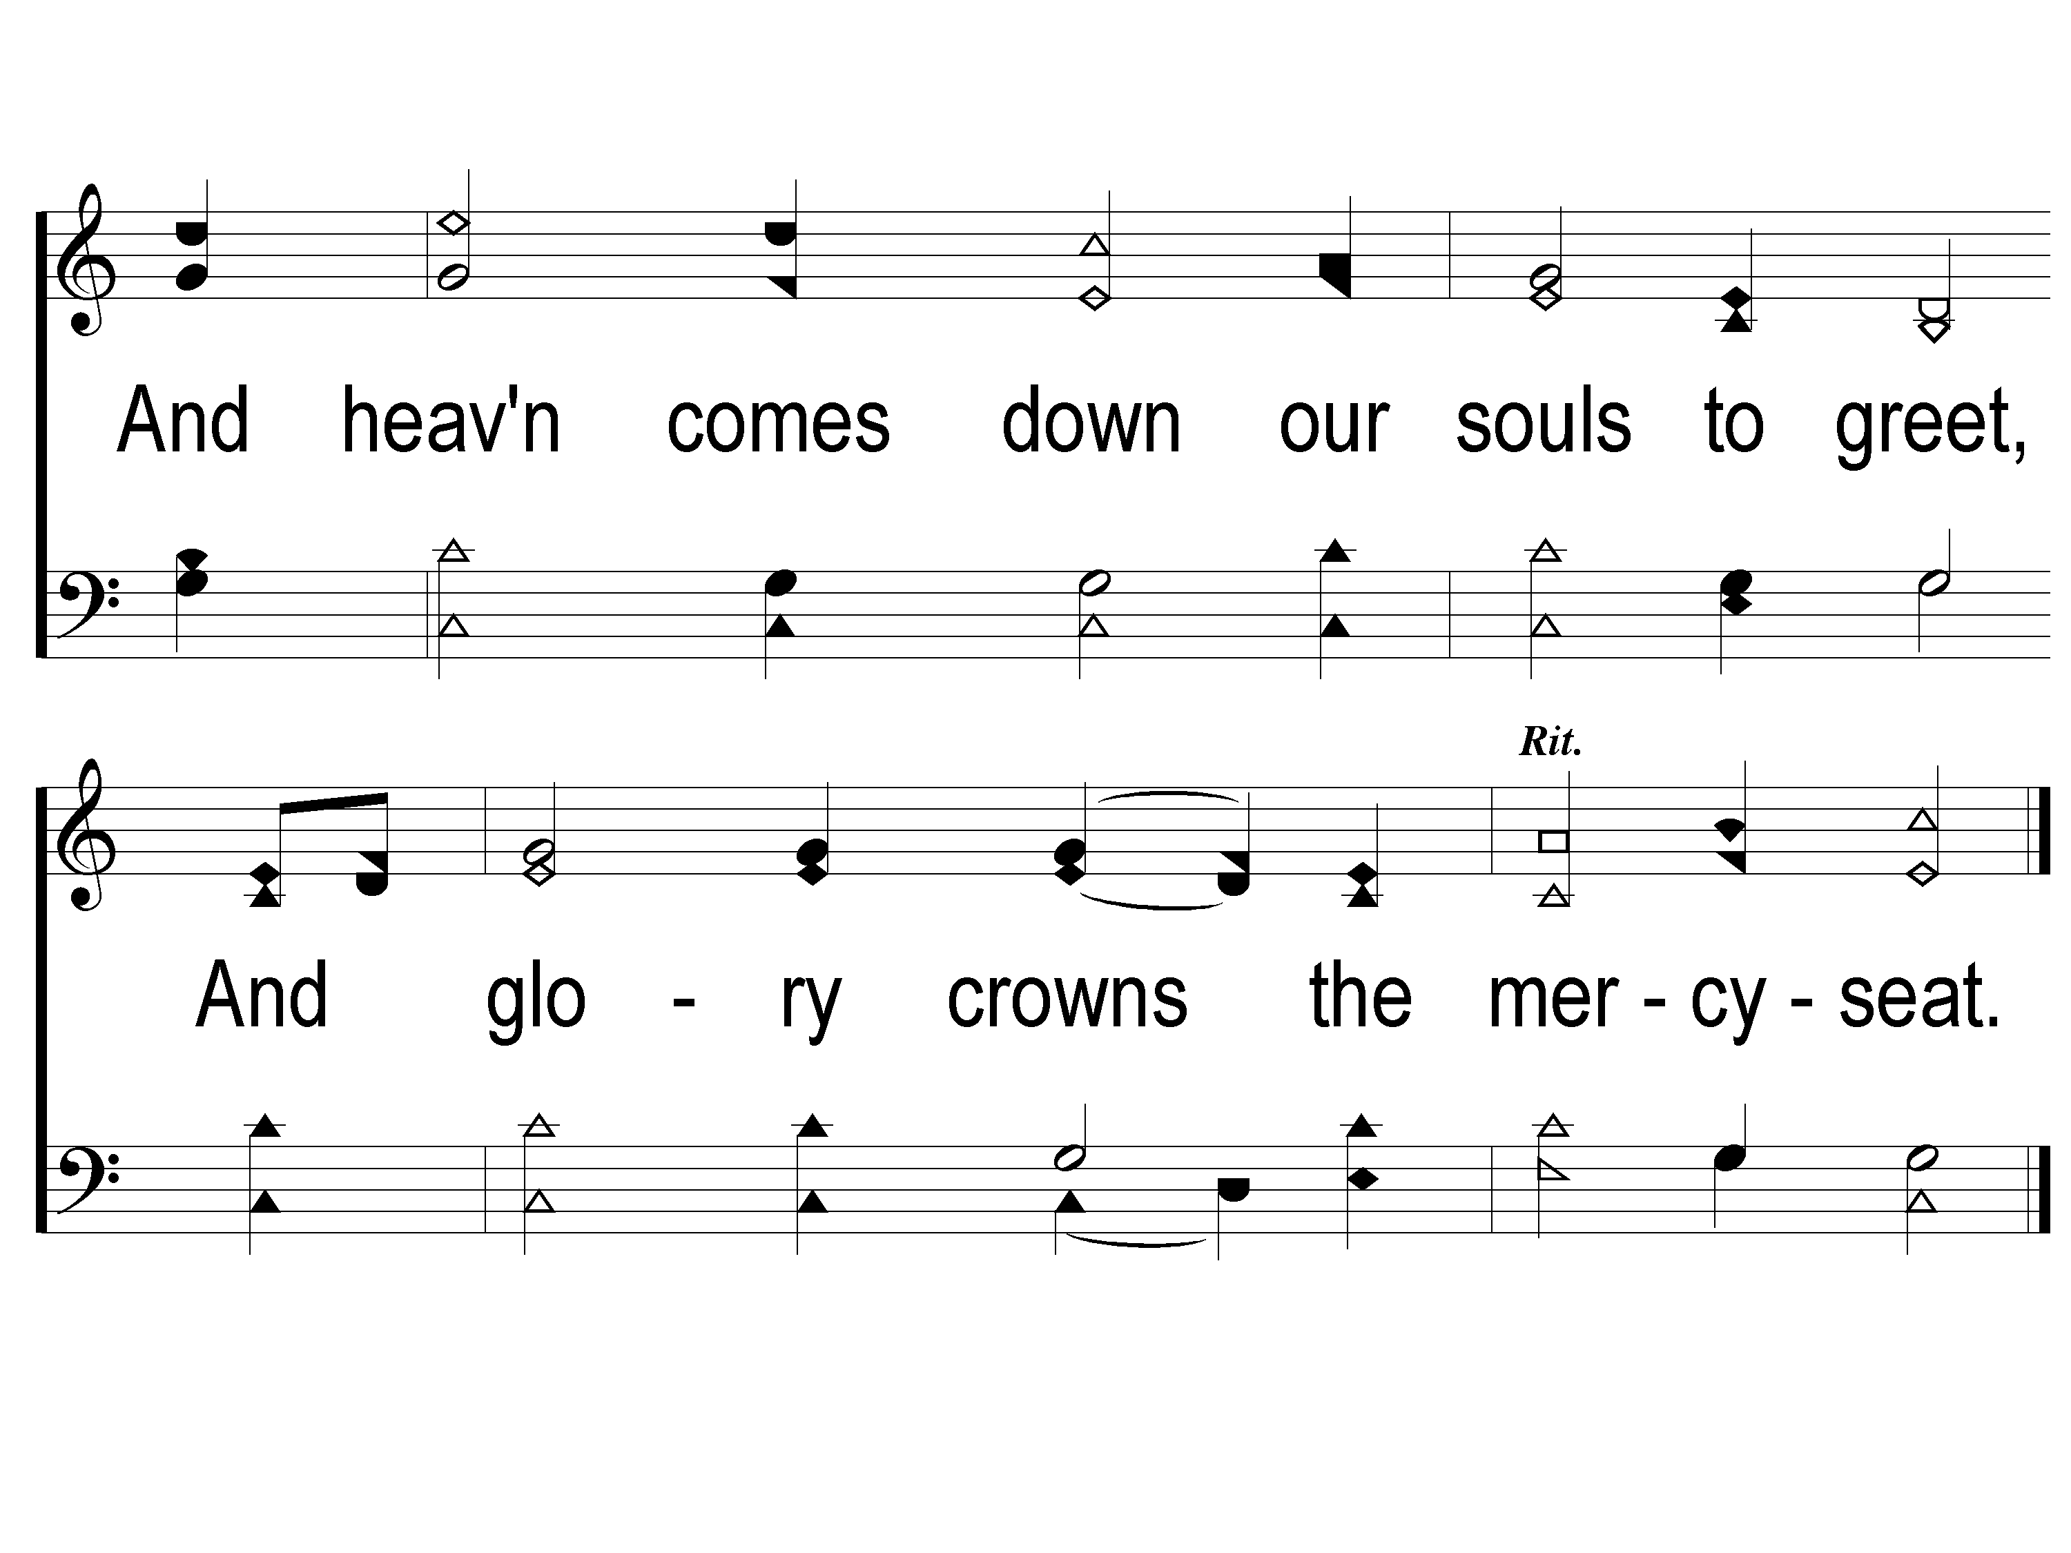
4-2 From Every Stormy Wind
From Every Stormy Wind
115

